Slide 1
Python for Data Handling and Introduction to Machine Learning Libraries
Course: Applied Machine Learning Lab
Learning Outcome
Understand the role of Python in data handling and gain practical knowledge of NumPy, Pandas, Matplotlib, and Scikit-learn for machine learning applications.
Course Coordinator
Dr Sameera P
Postdoctoral Fellow, MSIS, MAHE, Manipal

Slide 2
Prerequisite
Basic Programming in Python
Learning Objectives
Understand why Python is widely used in Machine Learning
Perform numerical computations using NumPy
Handle datasets using Pandas
Visualize data using Matplotlib
Understand the workflow of a machine learning project.

Slide 3
Why Python for Machine Learning?
Simple and easy-to-read syntax
Open-source programming language
Large developer community
Rich collection of libraries
Platform independent
Supports rapid prototyping
Easy integration with AI and Deep Learning frameworks
Popular Python Libraries
NumPy, Pandas, Matplotlib, Scikit-learn, TensorFlow, PyTorch, OpenCV

Slide 4
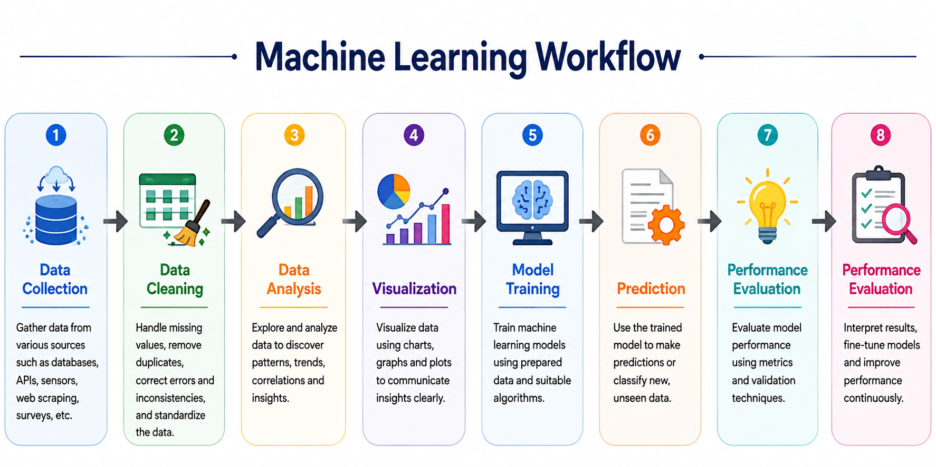

Slide 5
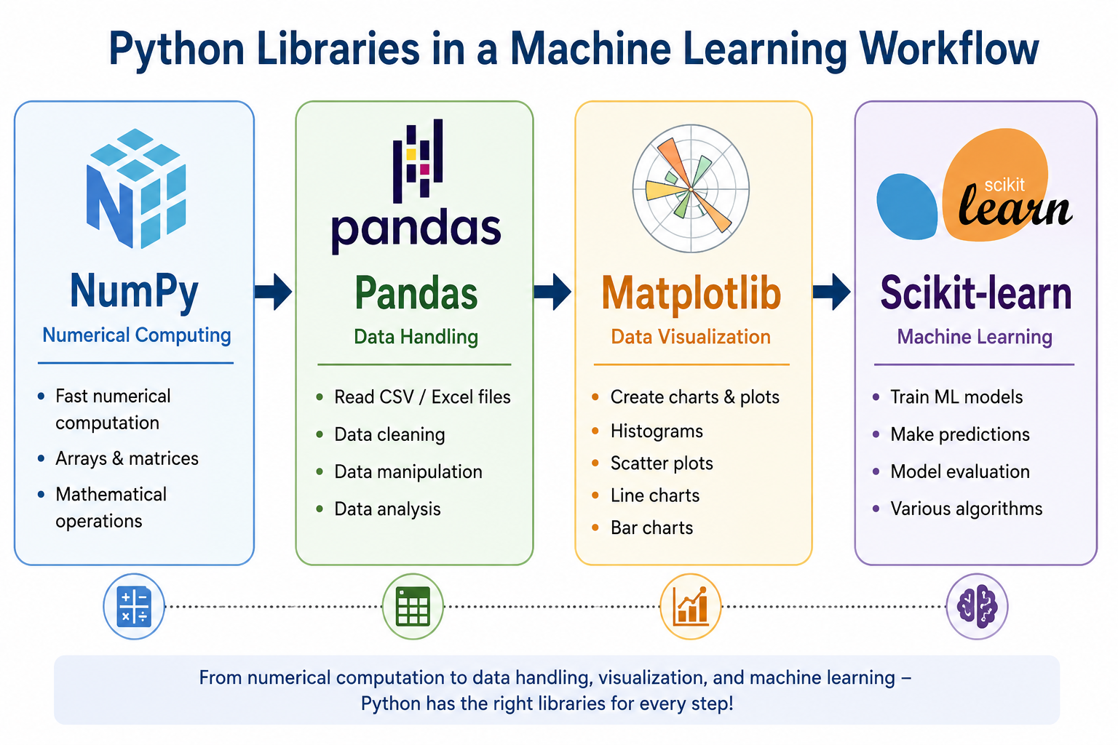

Slide 6
Introduction to NumPy
What is NumPy?
NumPy (Numerical Python) is the fundamental package for numerical computing in Python.
Features
Multi-dimensional arrays
Fast mathematical operations
Matrix manipulation
Statistical functions
Random number generation
Applications
Image processing
Scientific computing
Machine Learning
Signal processing

Slide 7
NumPy Activities
Activity 1
Creating arrays
Activity 2
Matrix Operation
Activity 3
Statistics

Slide 8
Introduction to Pandas
What is Pandas?
Pandas is an open-source Python library used for loading, organizing, manipulating, analyzing, and cleaning structured data.
Applications of Pandas
Reading CSV files
Reading Excel files
Data Cleaning
Missing Value Handling
Sorting
Filtering
Statistical Analysis
Pandas provide two types of Data Structures
Series
Data Frames

Slide 9
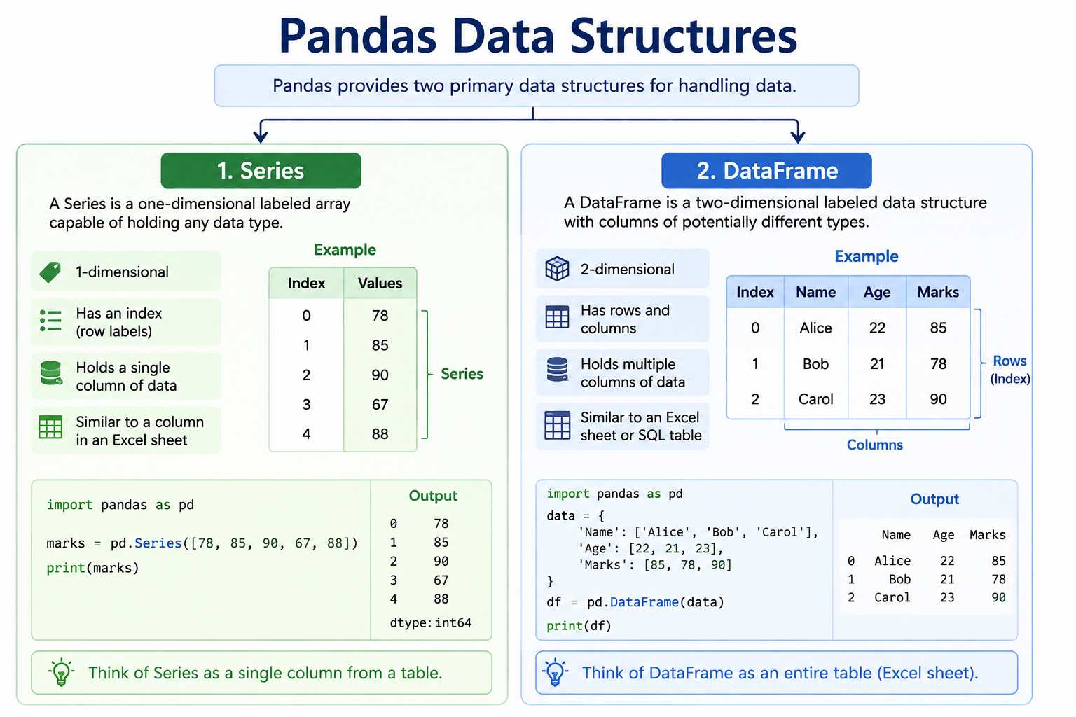

Slide 10
Pandas Activities
Activity 1
Create Data Frame
Activity 2
Reading Dataset
Activity 3
Basic Operations
Activity 1
Selecting Data
Activity 5
Filtering
Activity 6
Sorting

Slide 11
Introduction to Matplotlib
What is Matplotlib?
Matplotlib is a Python visualization library used for creating static, interactive, and animated graphs.
It helps transform numerical data into visual representations, making patterns, trends, and relationships easier to understand.
Key Features
Works seamlessly with NumPy and Pandas
Supports a wide variety of plots
Highly customizable
Produces publication-quality figures

Slide 12
Matplotlib Activities
Activity 1
Line Plot
Activity 2
Scatter Plot
Activity 3
Histogram
Activity 4
Bar Chart

Slide 13
Scikit-learn: Machine Learning Library
What is Scikit-learn?
An open-source Python library for machine learning
Built on NumPy, SciPy, and Matplotlib
Provides ready-to-use implementations of common ML algorithms
Supports the complete ML workflow:
Data → Preprocessing → Model → Training → Evaluation → Prediction
Why use Scikit-learn?
Simple and consistent API
Reduces the need to implement algorithms from scratch
Useful for classification, regression, clustering, and dimensionality reduction
Provides tools for model selection and performance evaluation

Slide 14
